Slide 1
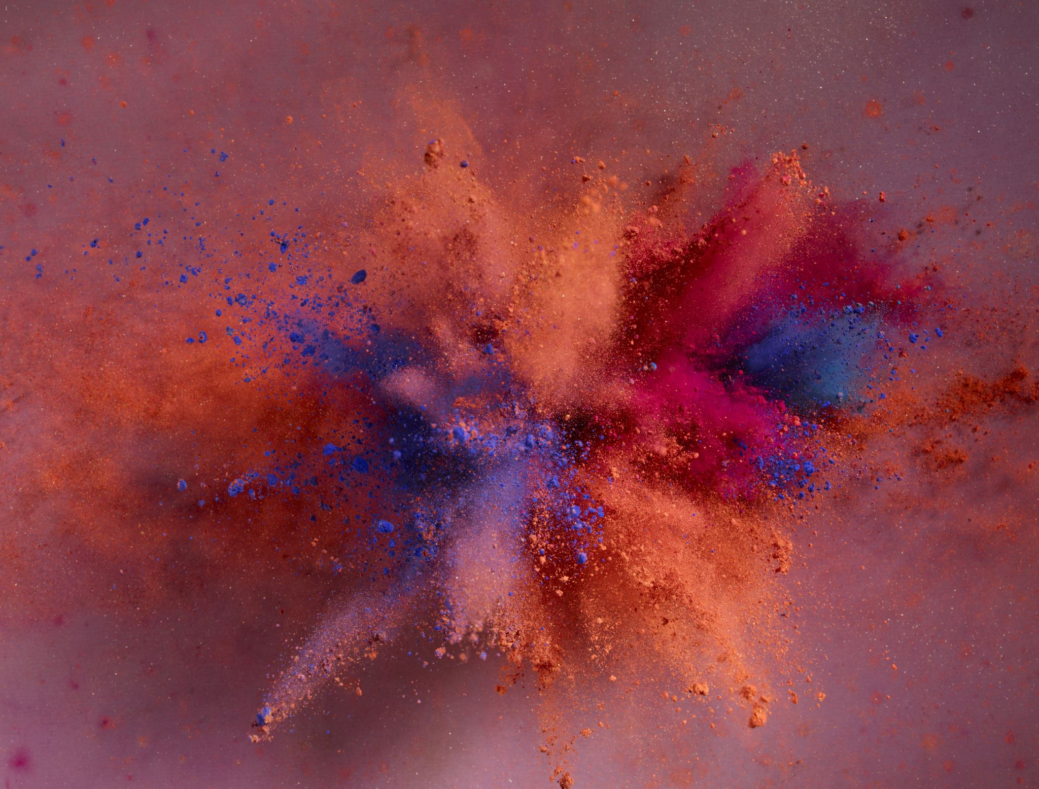
Live Face Mask Detection
Prajjwal Maurya

Slide 2
Objective
To effectively provide a working model for accurate face mask detection.
To develop an effective computer vision-based console application that detects face mask on real time.

Slide 3
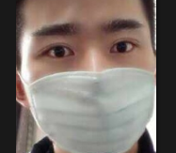
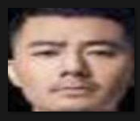
Dataset
Dataset is taken from kaggle online community.
Contains folder RGB images of face with and without mask in separate folders.
With mask: 1915 images
Without mask: 1918 images.

Slide 4
Methodology
Pre-processing of the dataset. Splitting of dataset into test, train and validation dataset.
Configuring a tensorflow pre-trained model(MobileNetV2)
Feeding test data to the model and finding accuracy.
Saving the model for the future use.
Using configured model to detect the face mask on continuous video stream using OpenCV.

Slide 5
Pre-processing of the dataset
Loading
Loading the dataset and converting its dimensions to 224, 224 pixels.
Encoding
Encoding our labels as
With mask- [1., 0.]
Without mask- [0., 1.]
Splitting
Splitting of our dataset into test-train-validation data.
Test size- 20%
Train size- 80%
Validation size- 15% of train data.

Slide 6
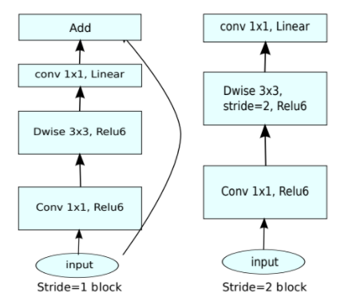
Configuring model
Pre-trained model MobileNetV2- MobileNetV2 is a convolutional neural network architecture that seeks to perform well on mobile devices.
Its features are-
Optimised for mobile devices.
Light weight.
Very less trainable parameters.
Requires less computational power.
High accuracy.
Inverted architecture

Slide 7
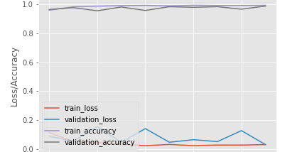
Feeding data and finding accuracy.
Feeding training and validation data to the model.

Slide 8
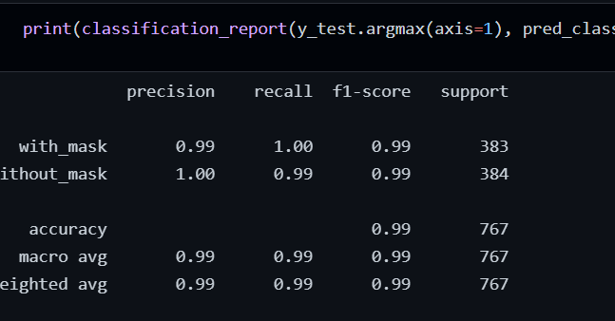
Accuracy
Feeding the test data to see how our model performs on the unseen data.

Slide 9
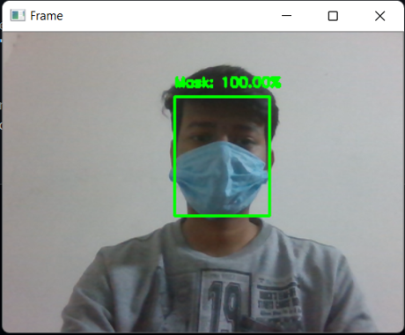
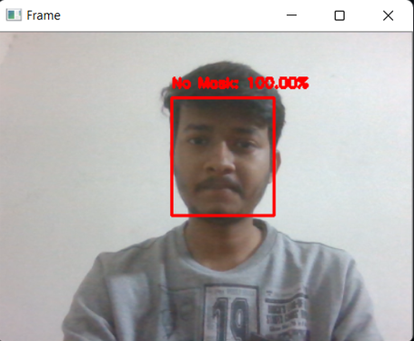
Prediction on the live video stream.
OpenCV is a huge open-source library for computer vision, machine learning, and image processing.
It can process images and videos to identify objects, faces, or even the handwriting of a human.
OpenCV is used to generate a continuous video stream and feed it to the model.
And finally, model shows whether the face has a mask or not with probability in the same video frame.

Slide 10

Thank you

